Slide 1
COURSERA CAPSTONE
THE CHEESE FONDUE RESTAURANT IN AMSTERDAM
BY CASPER WESSELINK

Slide 2
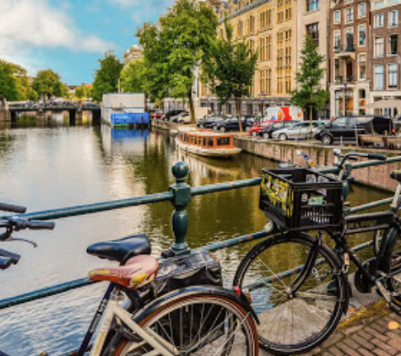
Goal
To determine the best place to start a Cheese Fondue in the city of Amsterdam.

Slide 3
The Problem
Many restaurants are allready in Amsterdam
Not clear how many people actually live in each borough
Are there allready Cheese Fondue restaurant in Amsterdam and where are they?

Slide 4
Data Needed for analysis
- Which boroughs are there in Amsterdam
- How many people live in these boroughs
- What are the coordinated of these boroughs
- What kind of restaurants are in each borough
- How many of same kind of restaurants are there in each borough
- Which boroughs have the lowest rate of Swiss, French and Ducth Cuisine
- Cluster the different neighborhoods to determine which Boroughs are more alike

Slide 5
Data Sources
- Wikipedia
- data.amsterdam.nl (open source data)
- FourSquare

Slide 6

Methodology
Determining data needed
Looking for data sources
Scraping data
Prepping data into pandas DF
Combining different data sources
Cleaning data
Mapping data with Folium
Using FourSquare to determine venues
Determine rate of restaurants in each borough
Clustering and Mapping
Reporting

Slide 7

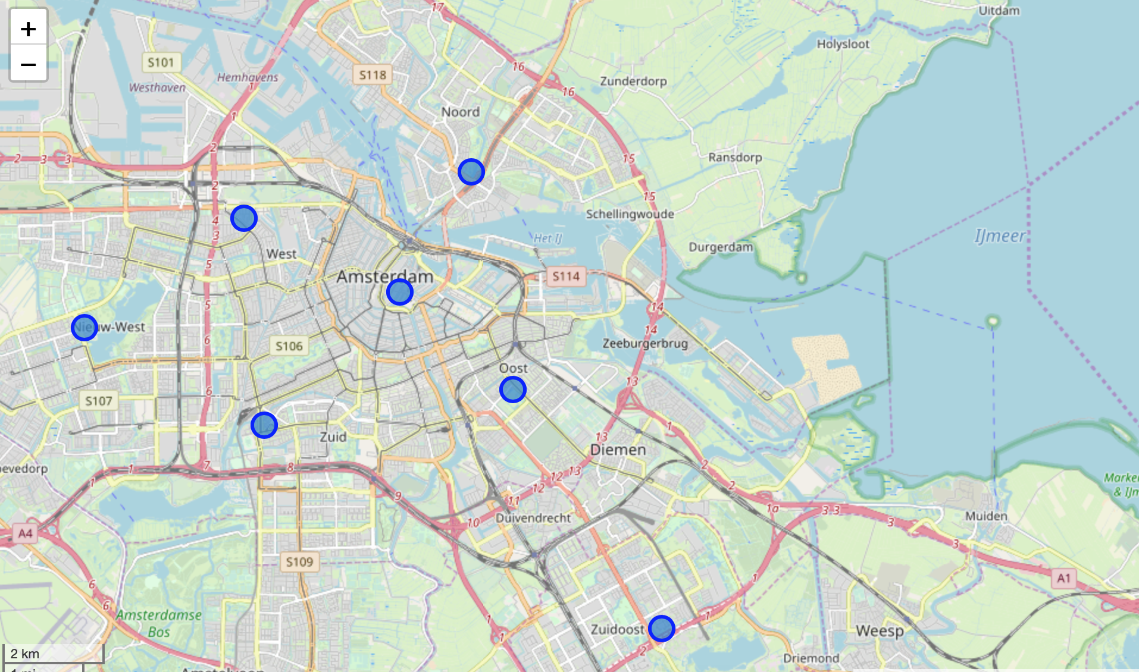
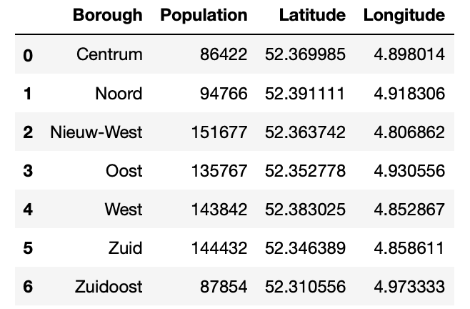
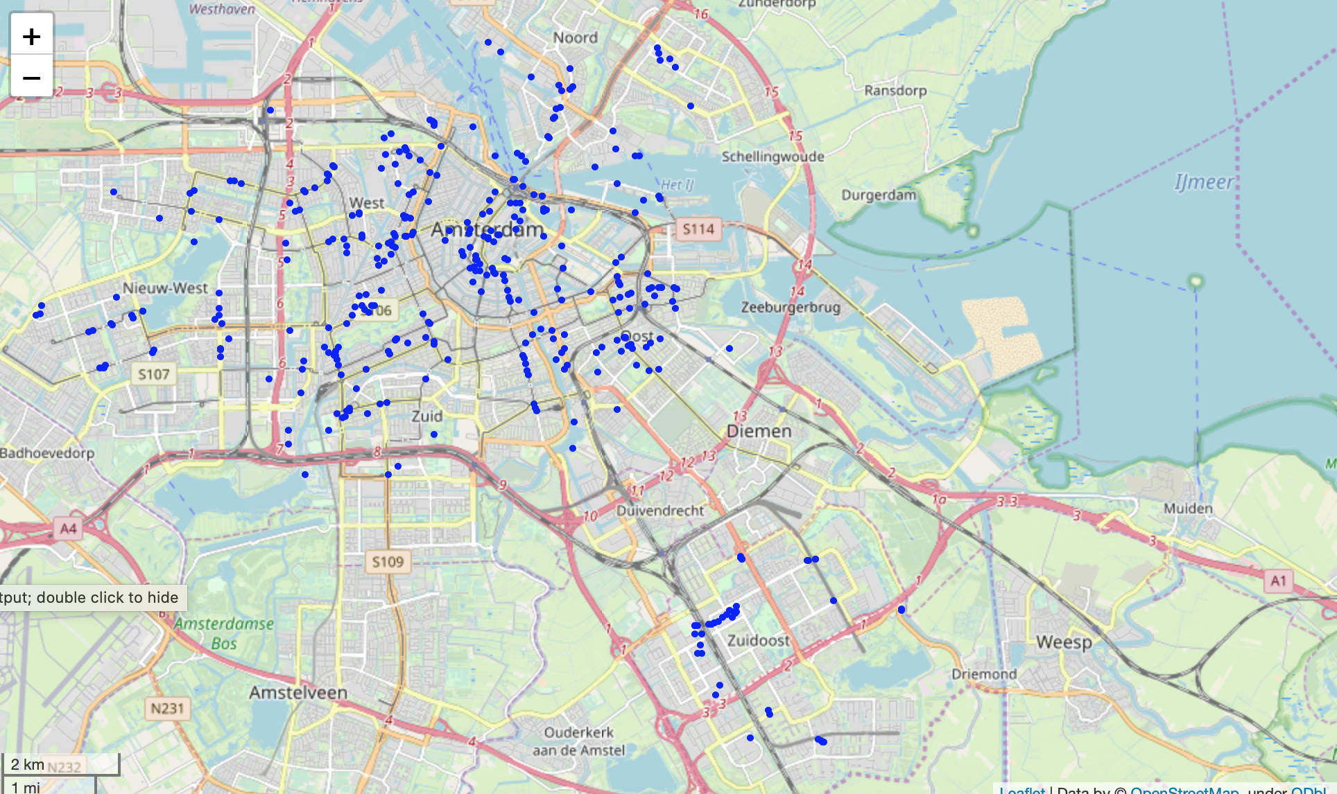
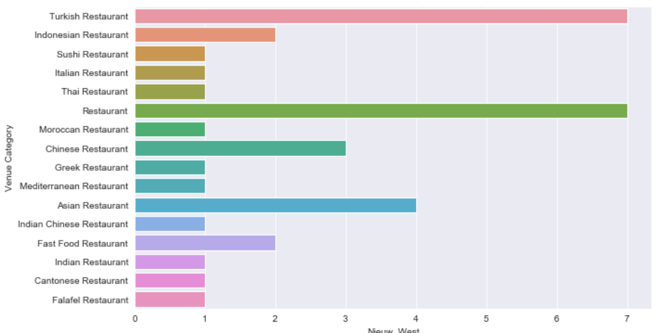
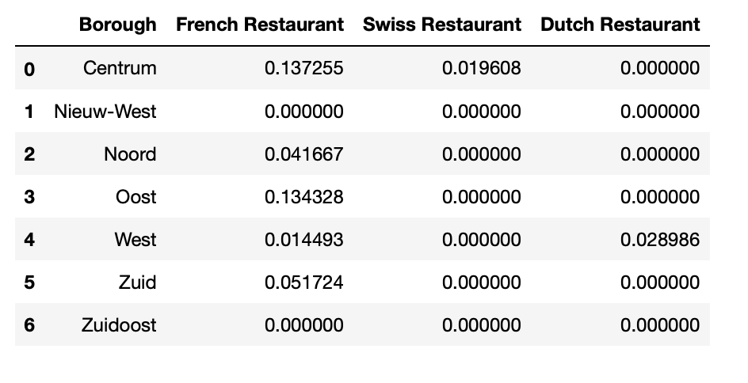
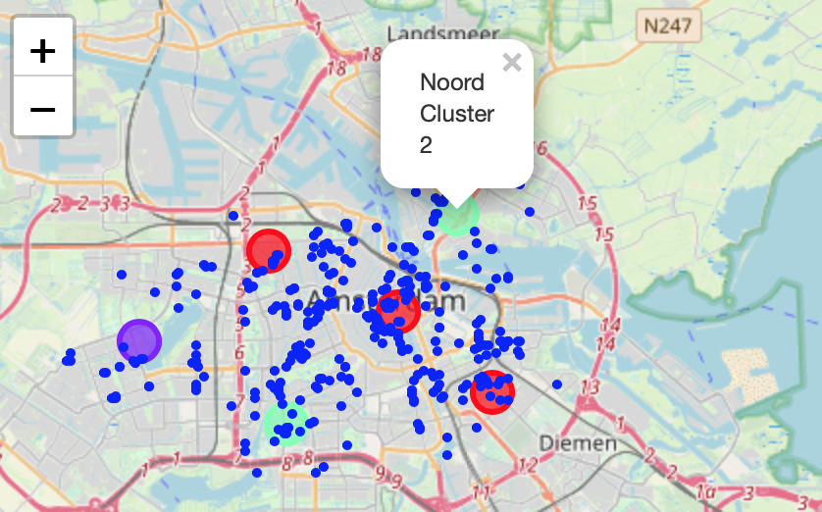
Results
Here you see the 7 different boroughs mapped out using Folium
I came down to 625 different Restaurants. There were a lot of excess venues in the dataset so i reduced the dataset to restaurants only
I visualized the amount of restaurants in each borough. Ultimately i came to the conlusion that there were 3 area’s well suited for a Cheese Fondue resturant. I reduced the dataset to only look at the French, Swiss and Dutch kitchen because these are most likely have cheese on the menu.
Eventually i clustered the different boroughs and it turned out that Noord (North) and Zuid (South) are in the same cluster and both have a really low rate of restaurant that potentially sell Cheese Fondue.

Slide 8
Discussion
I will opt for placing my restaurant in the North and South borough although additional research would be nice.
Thing that i will further look into are:
The actual menu’s of the French, Swiss and Dutch restaurants. Do they sell Cheese Fondue
I would further look into customer behaviour. How many people go out to dinner and to which restaurants

Slide 9
Conclusion
It was a challeging assigment and it took me quite a while to complete it.
In the notebook i have written some additional information on the process and outcomes of various data-analysis i did.
My Notebook also counts as my reports because of the additional information.

